Slide 1
Neighborhoods Similarities

Slide 2
Introduction
Moving can be a tricky decision in itself without having to deal with choosing the best area suited to you
Since it is hard to adapt to a new place we found that it helps for one to find place where can keep practicing his daily routines, like going to nearby gym in the morning or getting you coffee in café near your house before getting to work
Hence we came up with this idea where we try to find the most similar neighborhoods between two cities I to help people who are interested in moving out of their current neighborhood by recommending for them the neighborhood that best fit there lifstyle

Slide 3
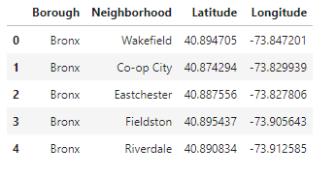
Data: New York Data
for new York Data we used a the same dataset we have used previously in the 3rd week lab in the course^{[1]} which provided a json file that contains an already well organized data that didn’t need much cleaning and looked eventually like this:

Slide 4
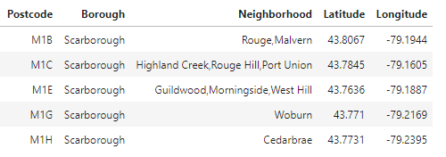
Data: Toronto Data
for the Toronto data we retrieved the boroughs and neighborhoods from a Wikipedia page^{[2]} using web scraping techniques and then we used the geospatial data file that was provided in the 3rd week assignment in order to add the coordinate for each area and after some cleaning by removing all unassigned boroughs and grouping neighborhoods that belongs to the same postal code we came with the following table:

Slide 5
Data: Merging the two Datasets
Finally, we did some formatting for the Toronto neighborhood data frame to match the same format of the New York Neighborhood data frame in order to concatenate them into one data frame that contains all neighborhoods after adding a suffix to each Neighborhood name to indicate the country the neighborhood belongs to, this step can be very useful if we decided to expand the project in the future to include more cities

Slide 6
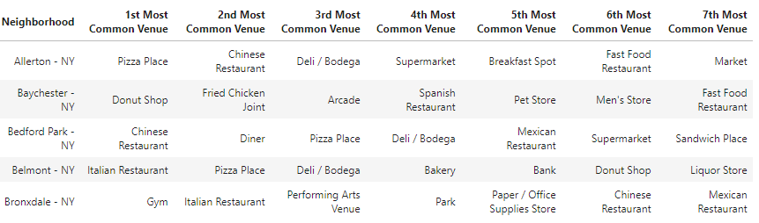
Methodology: Features
For the purpose of this project, we are going to be considering the venues surrounding a neighborhood to be the only deciding factor to determine the similarity between neighborhoods, as we will extract the X most common venues to use as the features of our model and after retrieving those feature we store them in a data frame which eventually looked like this:

Slide 7
Methodology: Model
For our model we chose a hierarchal clustering model specifically Agglomerative Clustering since it is the most commonly used hierarchal clustering model, and the reason behind this choice is that for our goal the hierarchal model can give us different levels of similarities as opposed to classical partition based clustering like K-means which can only define the similarity to be between points that belong to same cluster without considering hoe similar are they, whereas in a hierarchal model we can easily find the neighborhood most similar and dissimilar for any neighborhood which can give more options for our goal

Slide 8
Methodology: Libraries
beautiful soup : we used Beautiful Soup library as a web scraping library on order to retrieve the Toronto city data and format properly
Scipy: we chose Scipy library to represent our model and the reason we chose it over sklearn is that it provides easy and simple function to help us draw our dendrogram
FourSquare: we used FourSquare API to retrieve the all the venues nearby a specific location

Slide 9
Result
After training our model to fit our features we found that most neighborhoods that are very similar are within the same city but there a few exceptions like port Morris new York which we find that the most similar neighborhood to it is the ones inside the postal area M7Y which means that those two neighborhoods are closer to each other more than they are similar to other neighborhood within their same city.

Slide 10
Discussion
As we saw previously we were able to reach a model that can answer our question, However it is somewhat hard to measure the accuracy of mentioned model as it is the case with most clustering problems but that is okay in a way since the goal of this model is to give an approximate recommendation for someone looking to move to a new neighborhood and doesn’t want to change his/her lifestyle dramatically.
Yet there is still one big limitation in our project and it is that we didn’t use enough features to have the best decision possible since we considered the 7 most common venues to be the only deciding factor.

Slide 11
Discussion(Contd..)
So for future work we can add more features like land area, population density and average monthly temperature and other properties that can factor in one’s decision to choose a new living area. We can also try different models that can help us achieve our goal such as fuzzy clustering model which can be very useful to us since it supports a data point belonging to multiple clusters in different degrees on possibility.

Slide 12
Conclusion
In conclusion, we find that we can find hierarchal clustering model to help us find the most similar neighborhood for a specific neighborhood in order to help someone trying to decide on a new place to live without making dramatic changes to his/her routine but we find that one limiting factor in our work is the features we chose to help our model decision as it is not enough to help our model achieve the best decision possible thus it will add more feature in our future work.

Slide 13
References
[1]: https://cocl.us/new_york_dataset
[2]: https://en.wikipedia.org/wiki/List_of_postal_codes_of_Canada:_M

